Slide 1




Tweaking Phase Response with FIR Filters
Hadi Sumoro

Slide 2

This article is a subset of a webinar about Loudspeaker Optimization using FIR filters.
Originally presented in March 2021.

Slide 3
FIR filter, advantage:
Create mag and/or phs correction independently
FIR filter, limitations:
May introduce processing delay
Not effective for low frequency

Slide 4
Magnitude correction
Very straight-forward.
Easy to hear.
Meaningful correction.
Phase correction
Why FIR filter is popular.
Meaningful correction?
Can you hear the correction?

Slide 5
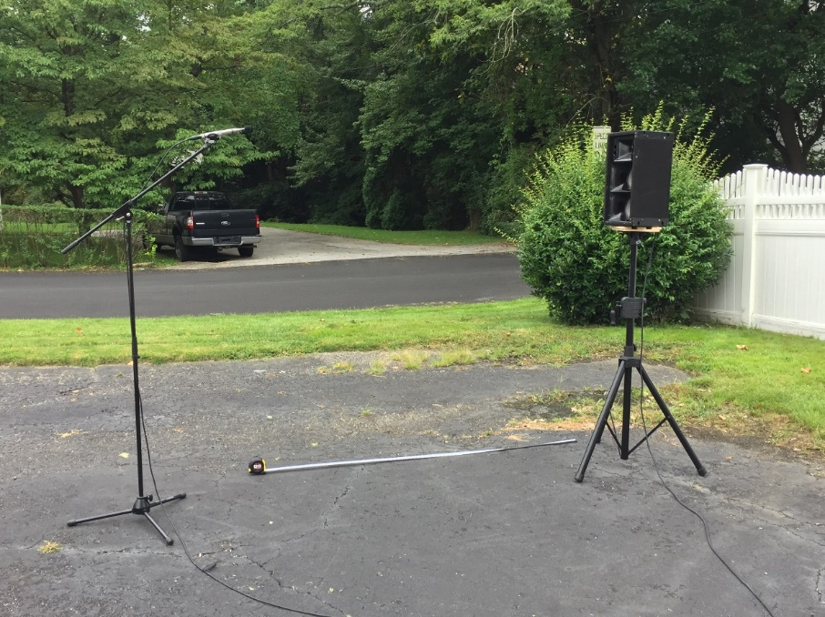
Loudspeaker in use: Community RS jr
Measurement was conducted outdoor as shown in the left picture.
Mic location: 2m away, 1.6m above the ground,
on-axis to the tweeter.
Tech Info: Dual FFT using EASERA, Window length is approx. 7ms, FIR filter is created using Filter Hose. Convolution is created using GratisVolver. Wave Editor: Nuendo 11.

Slide 6
A change in the phase response:
> Change the waveform shape
> Impulsive sound gets tighter (hard to hear and subjective!)
> Stereo image gets better (hard to hear and subjective!)
> Easier to hear with drastic phase change (ie. 6th order to flat phase)
> Does it matter?
Next slide: comparison of waveform with different transfer functions. Please note the difference of the waveform when the phase response is different.

Slide 7
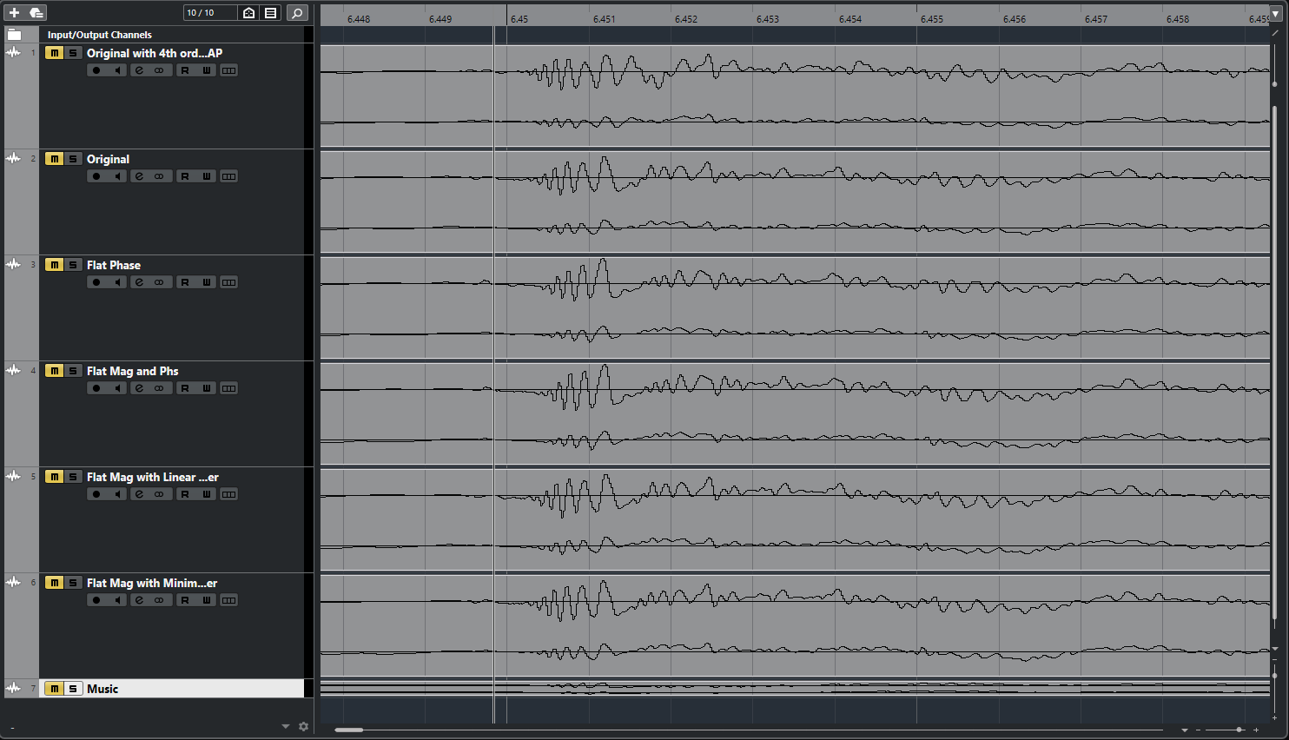
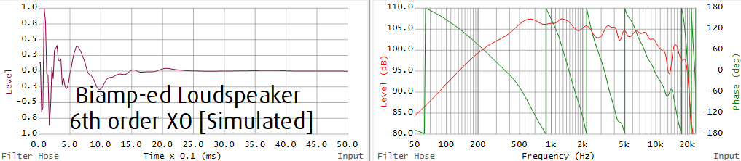
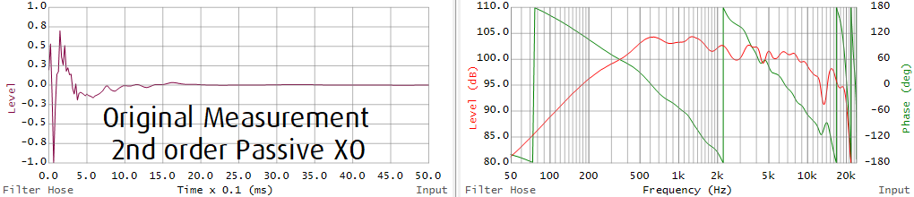
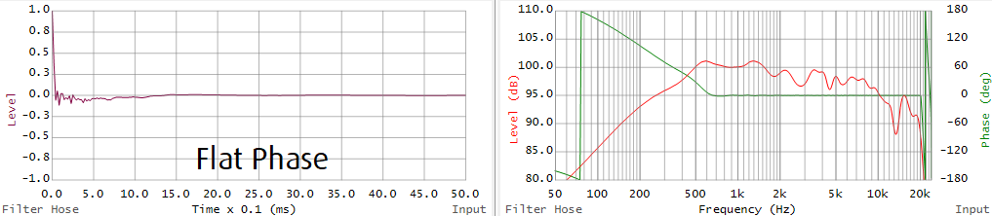
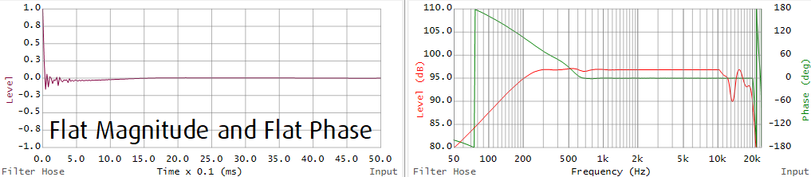
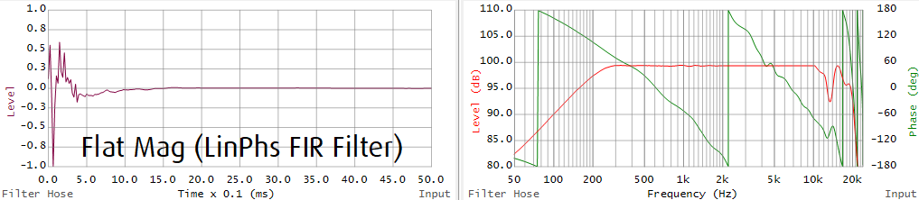
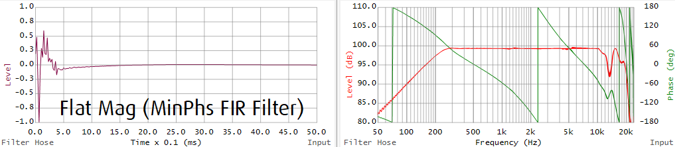
Loudspeaker Correction

Slide 8
Please use Headphones!
Click on the loudspeaker icons to play the sound.
PDF: Use Adobe Reader
PPSX: Requires Office 2016 or newer

Slide 9
Loudspeaker Correction
Listening 1
Original Response
vs
Flat magnitude & phase
vs
Flat magnitude only

Slide 10

Loudspeaker Correction

Slide 11
Loudspeaker Correction
Listening 2
(Same magnitude, different phase response)
Original Response
(Passive Crossover 2nd order)
vs
Bi-amp
(6th order active min phase crossover at same freq point, no change on the magnitude)
Vs
Original Response + FIR
(No change on the magnitude, flat phase)

Slide 12
Loudspeaker Correction

Slide 13
F.A.Q: If less phase drop or flat phase is preferred, when do you use higher order (> 4th order) crossover?
We do not suggest that flatter phase is preferred or better sounding.
In engineering, there is no free lunch. There are always pros/cons to a method. Low order (< 4th order) crossover can reduce the phase drop and reduce the processing delay of an FIR filter to further flatten the response. High order (>= 4th order) crossover can result in lower distortion, higher output capability and cleaner sound. Certainly, we do not want low order crossover breaking the transducer in a long-term high-power use, do we?
What’s the application of the loudspeaker?
What’s the goal of the filter?
Is the change (phase resp change) meaningful to the project’s objectives?
We can reduce our appetite of having flat line to the eyes, because the ears don’t ‘see’ that. It’s better to focus on the bigger picture first.

Slide 14
THANK YOU!
Contact info:
Hadi Sumoro
HX Audio Lab
www.HXAudioLab.com
Song for auralization: A Thousand Roads, composed by Ulf Anneken

